Slide 1
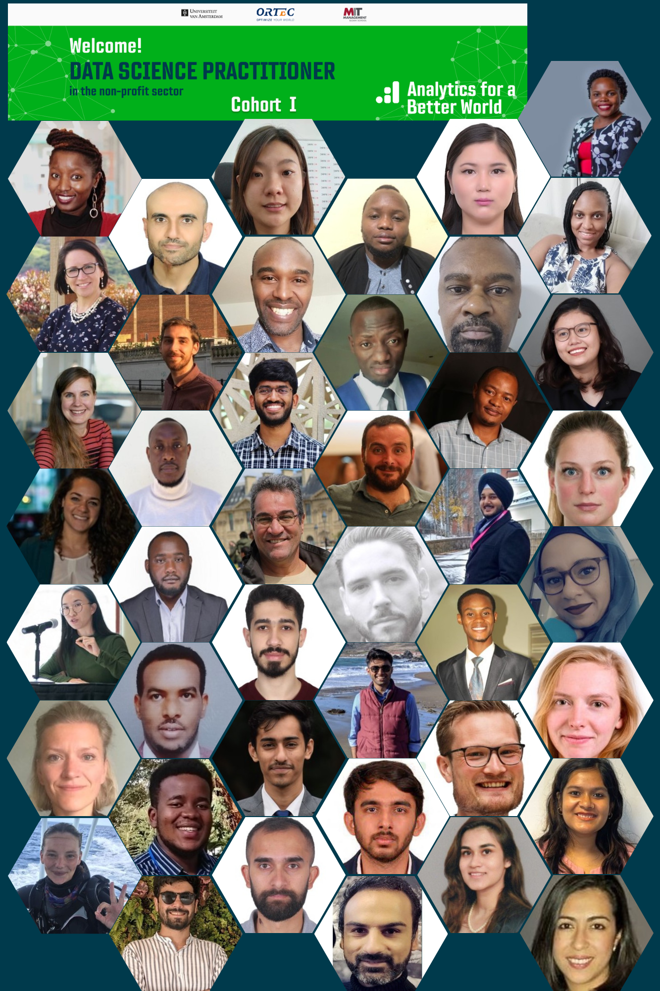
Data Science Practitioner
Fellowship Cohort 2022
Final Project Presentation
Numerical Wave Models for The Ocean Cleanup
IVAN SOARES
THE OCEAN CLEANUP
MENTORS: IGOR BRIGADIR & DONATO MARAGNO
6th December 2022

Slide 2
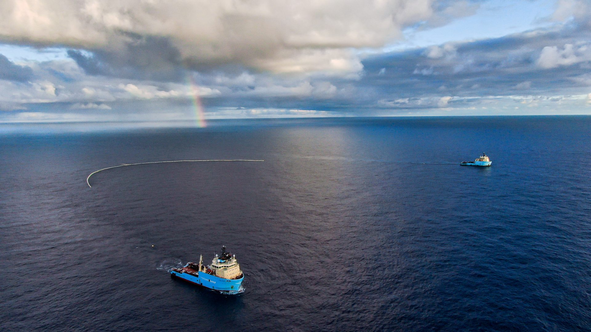
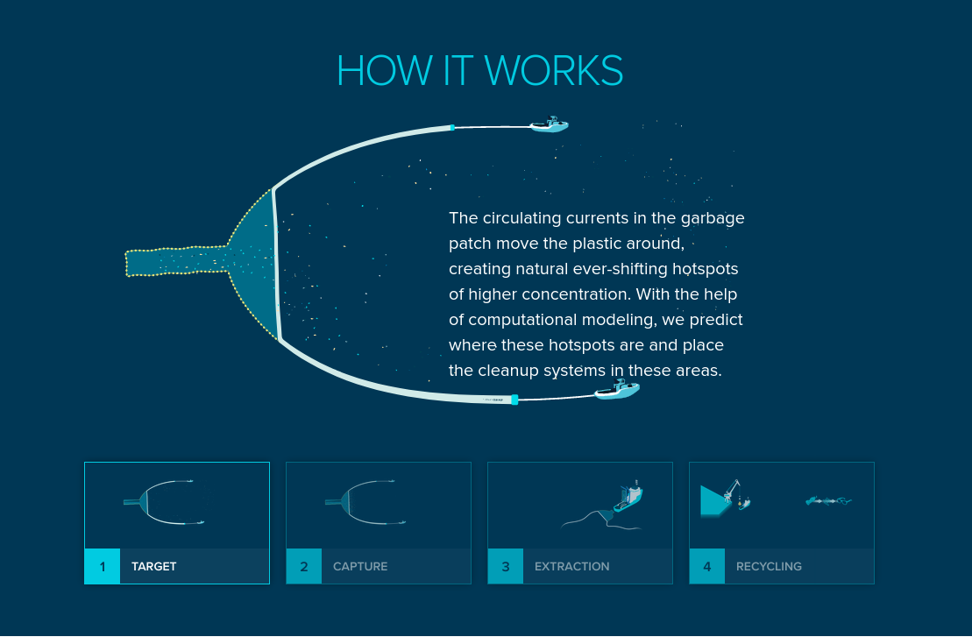
Business Case
The Ocean Cleanup has developed a floating system which captures plastic debris in the ocean.
The system is operating in the Northeastern Pacific Ocean.
The efficiency of the system depends on being deployed where the concentration of plastic is higher.
The areas with higher concentration of debris are mapped by numerical models which take in consideration the winds, the waves and the ocean currents !!!

Slide 3
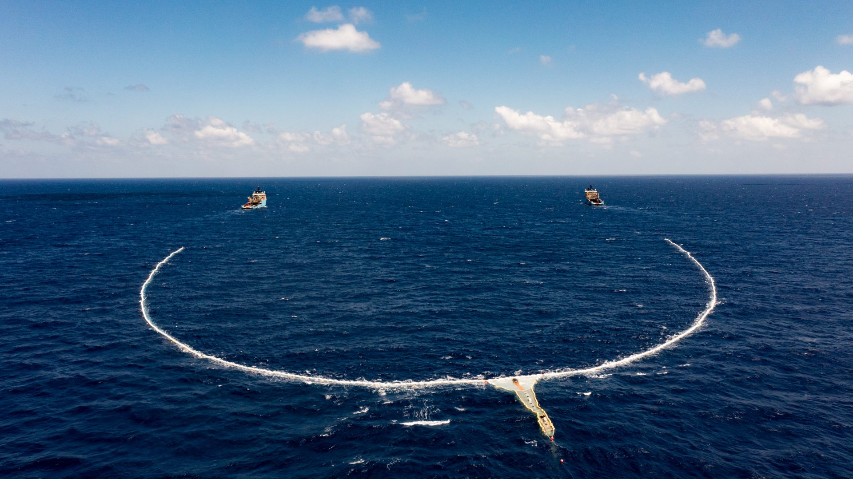
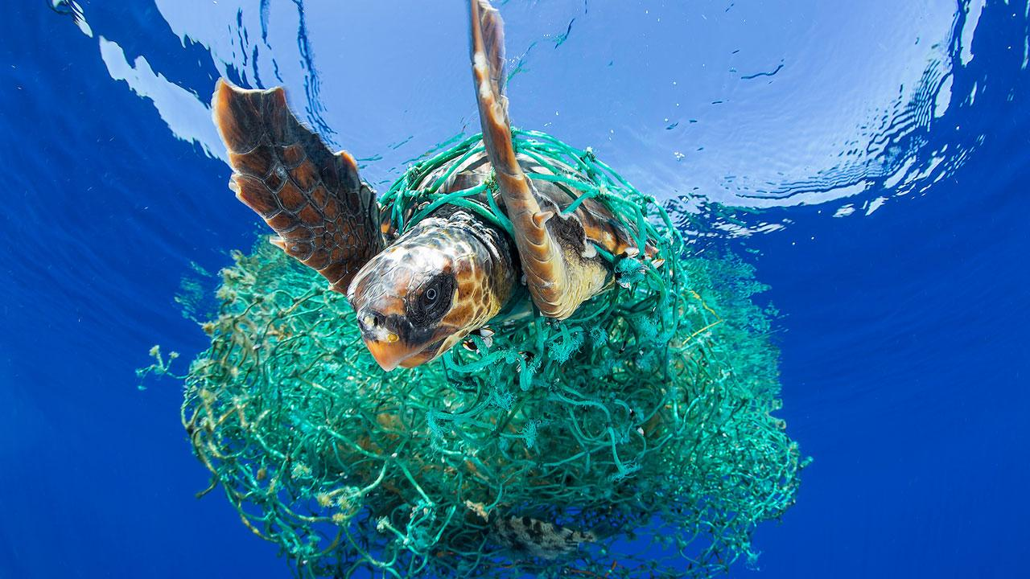
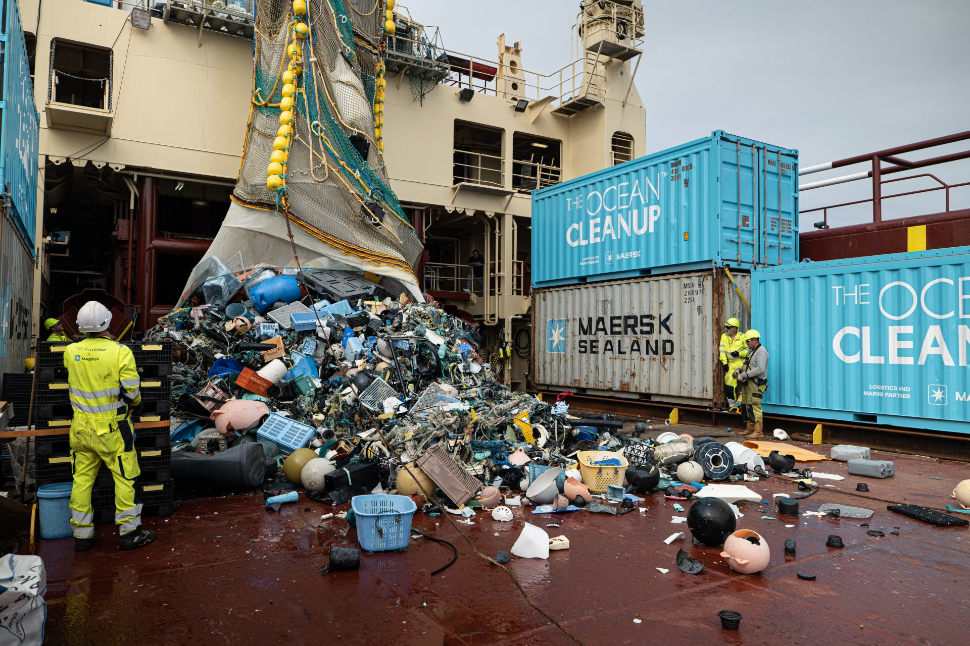
Business Case
In short:
predicting the location of the areas with higher concentrations of plastic debris saves lots of money for The Ocean Cleanup !!!
And helps saving sea life !!!

Slide 4
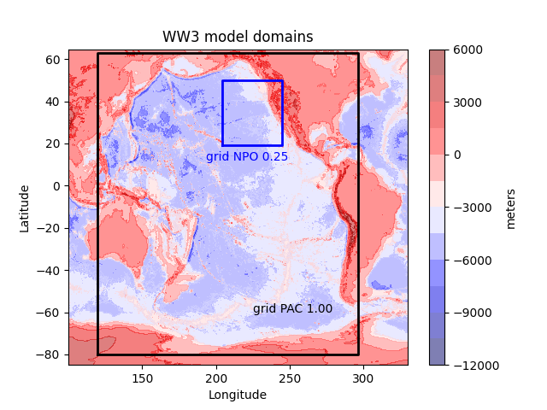
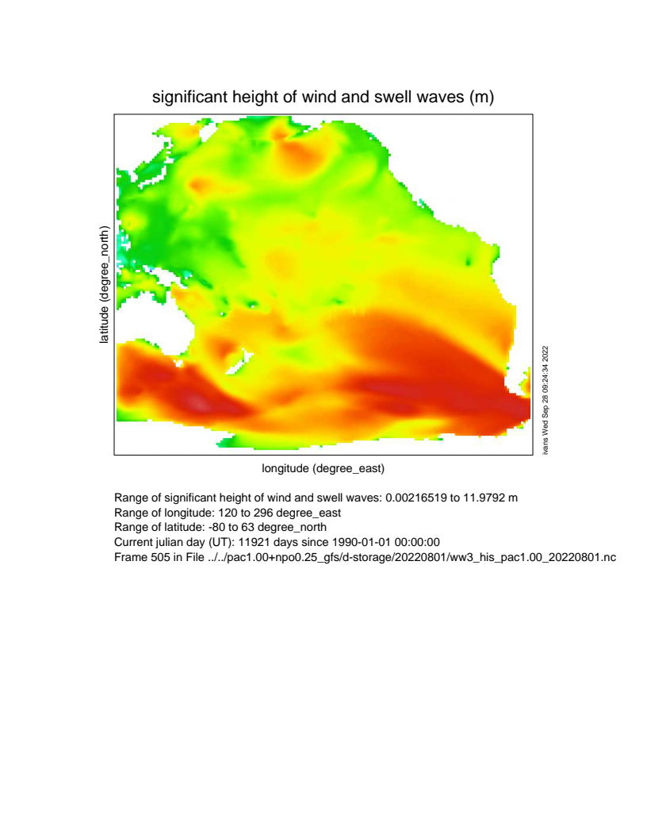
Methods or Tools Used
We use a numerical model to predict the ocean waves.
Knowing predicted wind velocities and wind directions the wave model can predict wave height, wave period and wavelength !!!
We get the predict winds from the Global Forecast System (GFS).
The wave model is the Wave Watch III model, developed at NOAA/NCEP.

Slide 5
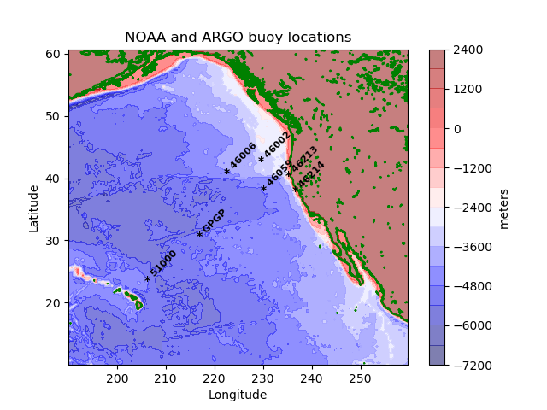
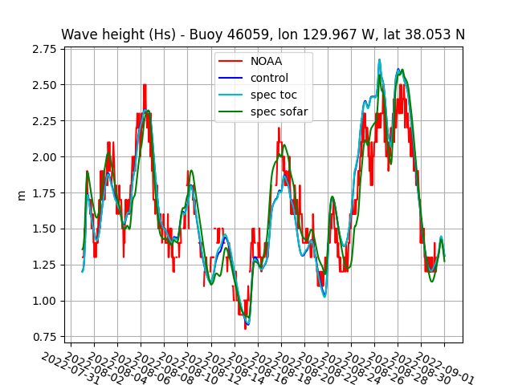
Methods or Tools Used
The wave heights predict by the model are compared to the wave heights observed in NOAA Buoys.
Thats is how we know how accurate the model predictions are !!!

Slide 6
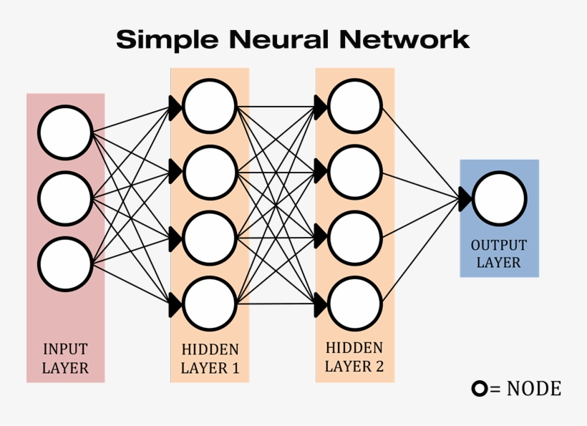
Methods or Tools Used
We want to improve the accuracy of our model !!!
Use a neural network that can be trained on the existing numerical wave model to reproduce the wave spectra observed at scattered locations to a larger domain.

Slide 7
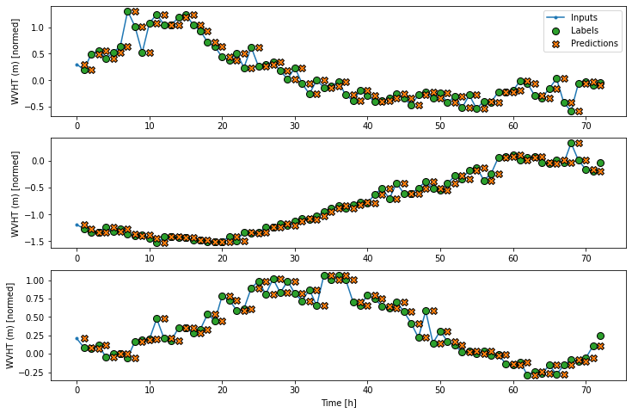
Methods or Tools Used
I started from an example which uses the Jena Climate dataset recorded by the Max Planck Institute for Biogeochemistry and delivers air temperature forecast.
In this example, the tensorflow function tf.keras.utils.timeseries_dataset_from_array is used to do time series forecasting.
The model is trained on the input time series to deliver forecasts at the same location of the input data.
I have adapted the code to do time series forecast of wave height.

Slide 8

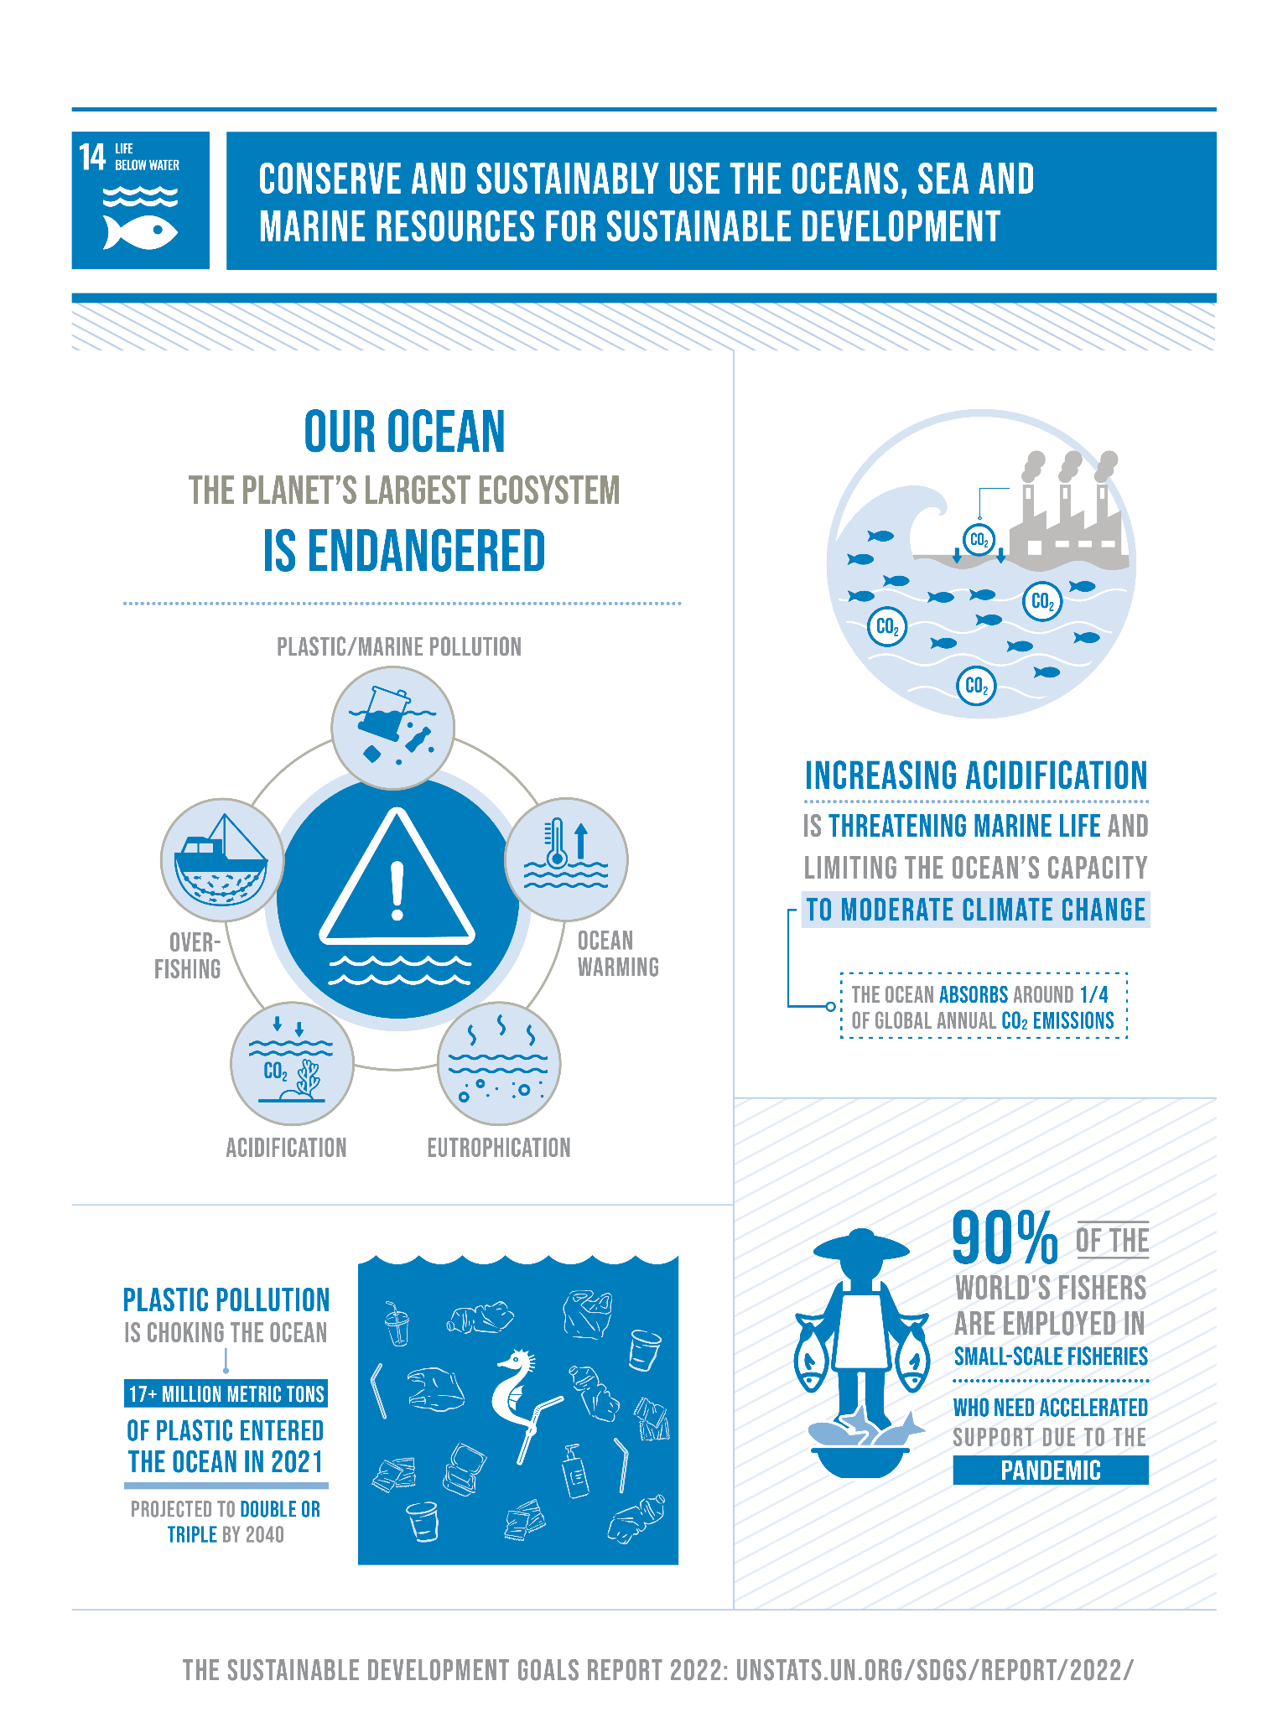
Most Significant Change
Expected Most Significant Changes are:
In my work: a more reliable forecast system.
In The Ocean Cleanup: economic impact : will reach its objective sooner and save money in offshore activities.
In the Sustainable Development Goals: GOAL 14 (Life below water): tackle plastic pollution in the oceans

Slide 9
Key Learnings
Key Learnings : The outputs of the Neural Network strongly depends on the quality of the inputs: missing values, observation error, observation interval, pre-processing.
Next Steps : I have done just a few simple cases, now I need to prove the feasibility of the project in a larger scale.

Slide 10
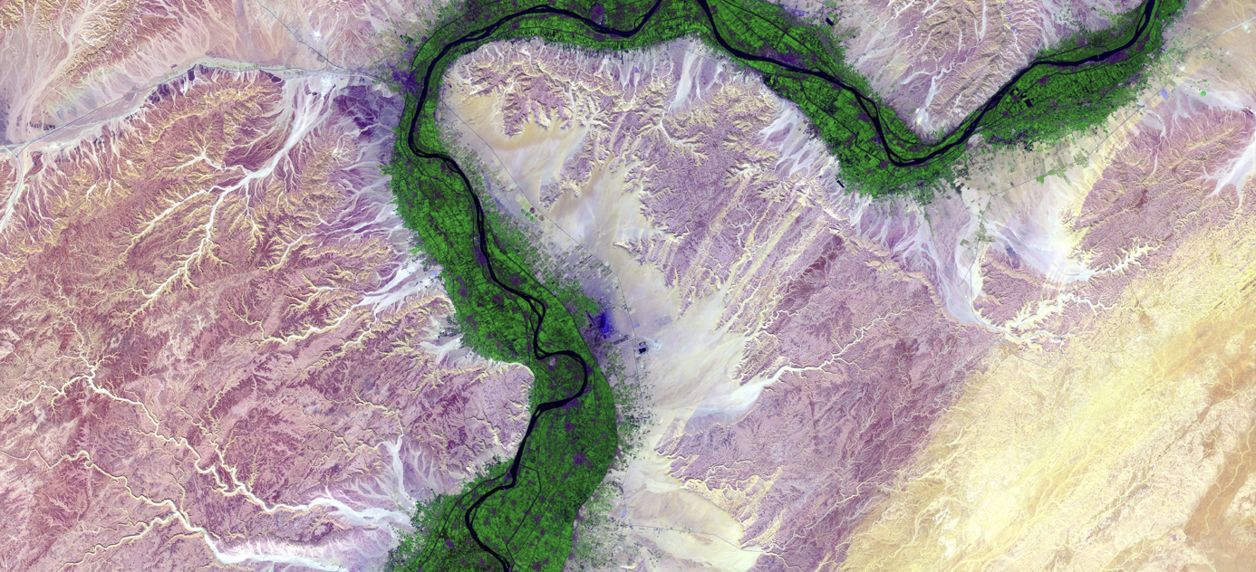
Thank you for your attention!
https://analyticsbw.org/
https://www.linkedin.com/company/analytics-for-a-better-world/
academy@analyticsbetterworld.org

